Slide 1
Government FINANCIAL OVERSIGHT SYSTEM (PSFOS)
Molebogeng baloyi

Slide 2

AGENDA
INTRODUCTION
Problem statement
Solution
Data structure
Screenshots

Slide 3
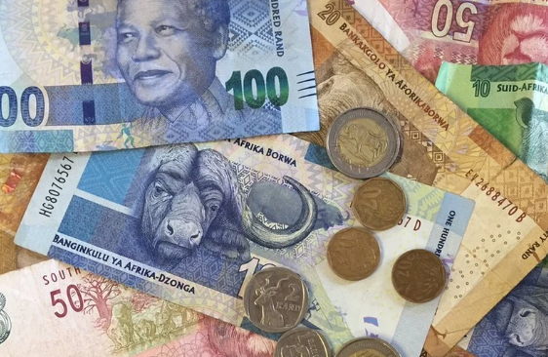
INTRO
This project proposal entails the development of a blockchain-based system to monitor and oversee funds allocated for government infrastructure projects.
The decentralized ledger includes budgeting, and reporting ensuring transparency, immutability, and auditability to prevent corruption and resource misallocation. User-friendly navigation and robust security protect sensitive financial data.

Slide 4
Problem statement
Governments globally face significant challenges with corruption and financial mismanagement in infrastructure projects, resulting in incomplete projects and public distrust. Existing solutions lack comprehensive transparency, immutability, and auditability, leading to ineffective oversight of public funds.

Slide 5
What is the solution????
“
”

Slide 6
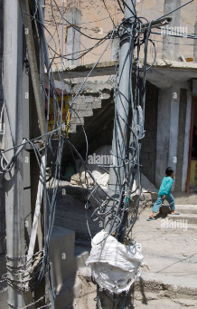
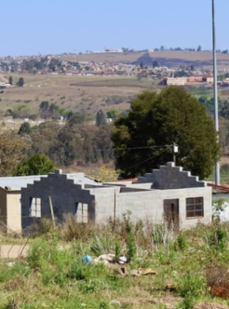
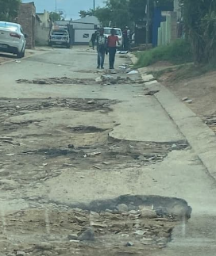
solution
Proposing a blockchain system for transparent communication between government officials and project contractors. Users log in to exchange project details securely, with transactions validated and permanently recorded by all participants, ensuring transparency and accountability. The system also enables notifications for submitted and completed projects, enhancing communication and project tracking capabilities.
potent features, include:
Decentralization reduces dependence on a single authority, mitigating cyber-attack risks.
Immutability prevents data alteration, crucial for preventing corruption concealment.
Transparency provides accessible transaction history, crucial for accountability.
Security measures like cryptographic techniques enhance transaction security against cyber-attacks.

Slide 7

DATA STRUCTURE
This blockchain project uses ArrayList for transaction management, offering scalability and flexibility. ArrayList dynamically resizes for varying transaction volumes, maintains chronological order, and supports efficient operations like adding and updating transactions. Its memory-efficient design optimizes resource utilization, making it suitable for handling large transaction volumes in the blockchain system.

Slide 8
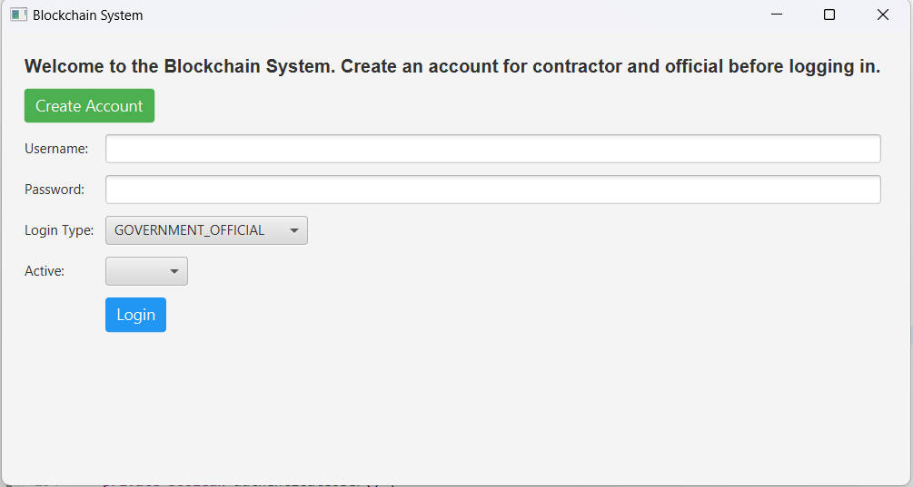
screenshots
First create an account for the contractor and the government official before trying to login.

Slide 9
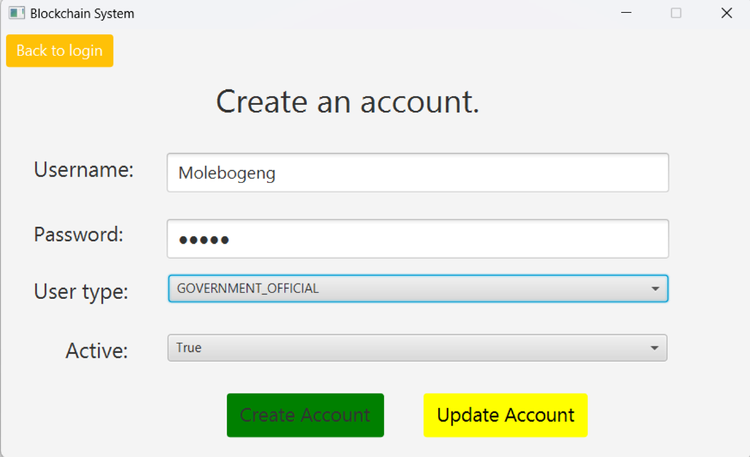
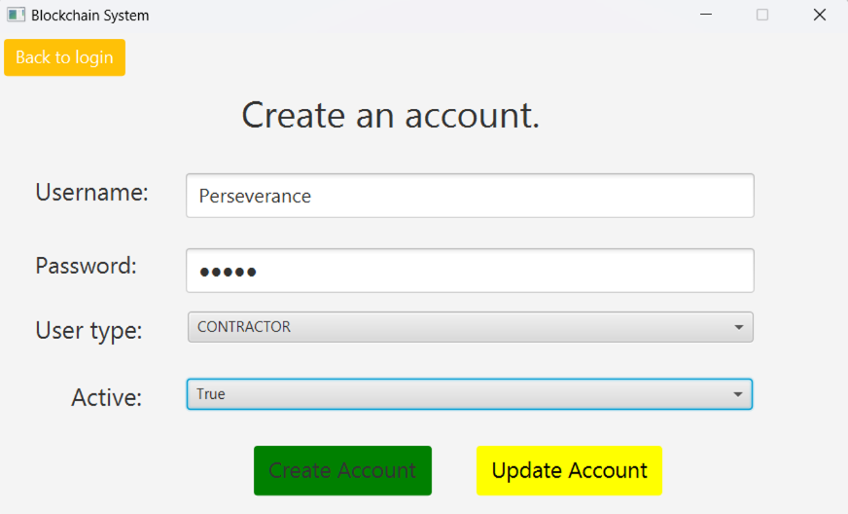
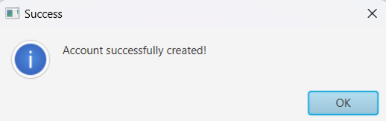
Create accounts for both users, since they are important for the rest of the program. Transactions will not be made to unregistered contractors.
Ater creating the accounts, navigate back to login.

Slide 10
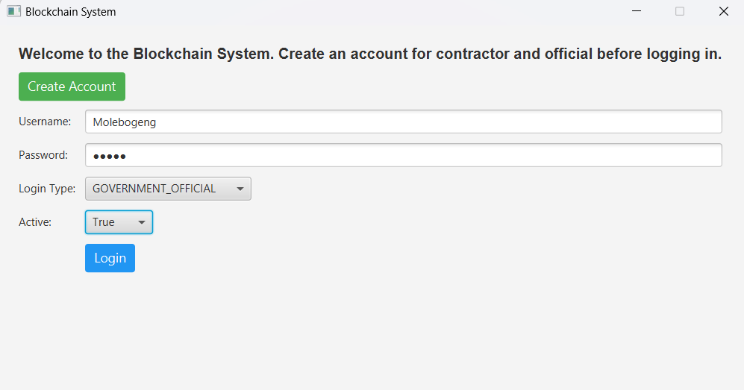
Log in as the registered Government official first, you will be redirected to the Government Official dashboard.

Slide 11
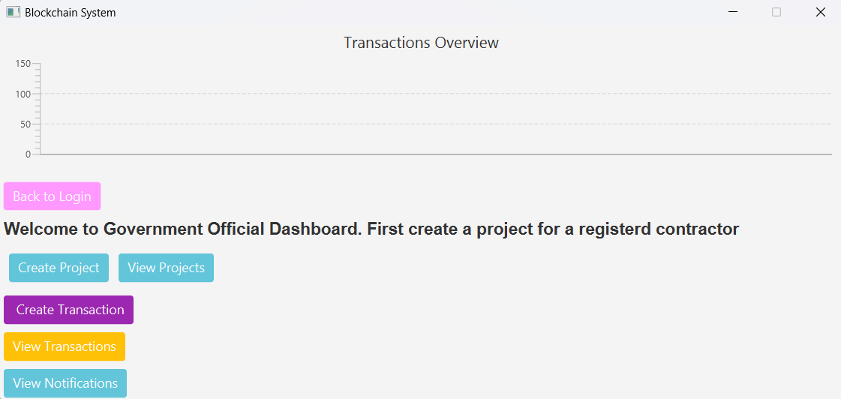
This is the Government Official dashboard.
Graph is currently empty because no transactions have been made yet.
Click on the create project button to be redirected to the create a project page.

Slide 12
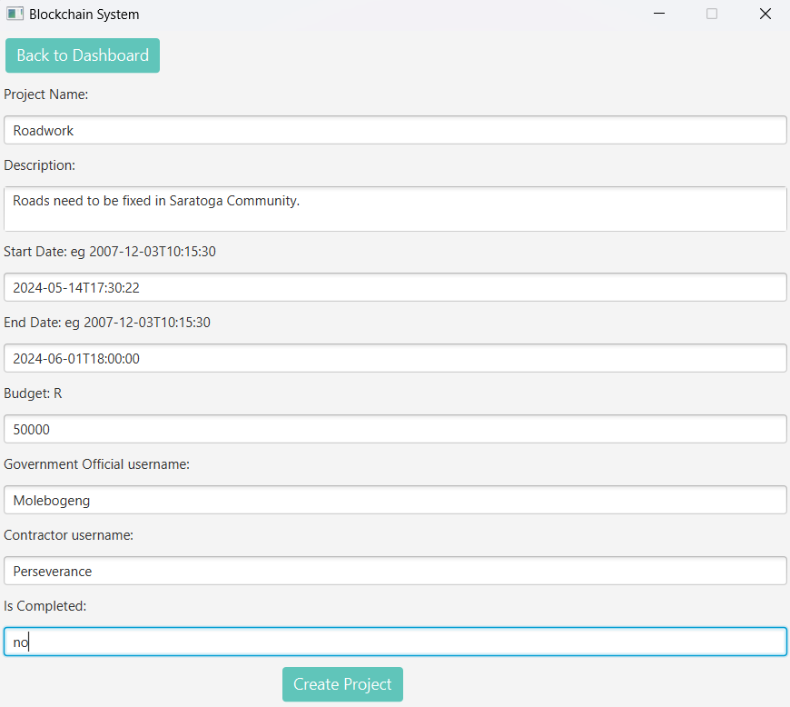

Enter project details to create a project for a registered contractor. Then click create project.
Take note of the date/Time format yyyy-mm-ddThh:mm:ss

Slide 13
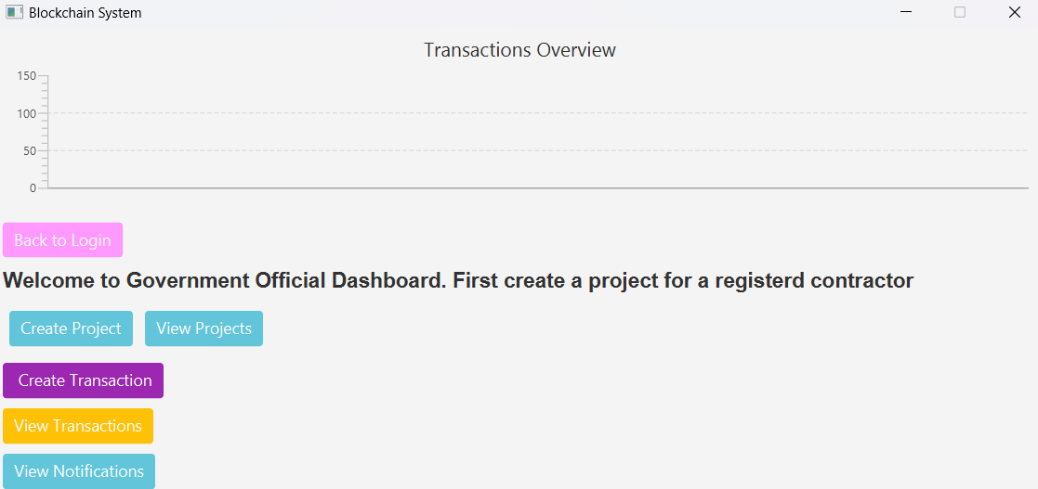
Navigate back to dashboard and click view projects to view created projects.

Slide 14
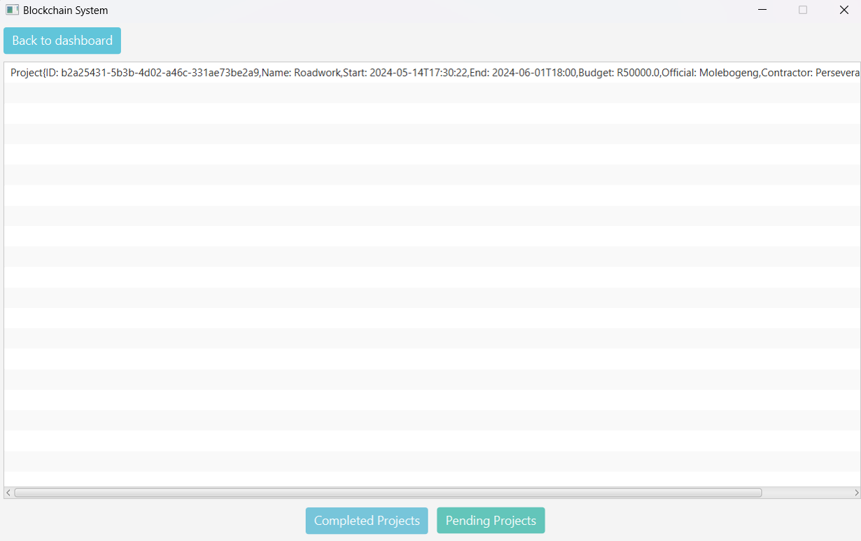
Project is available under pending projects.
Click on the project to view the project details.

Slide 15
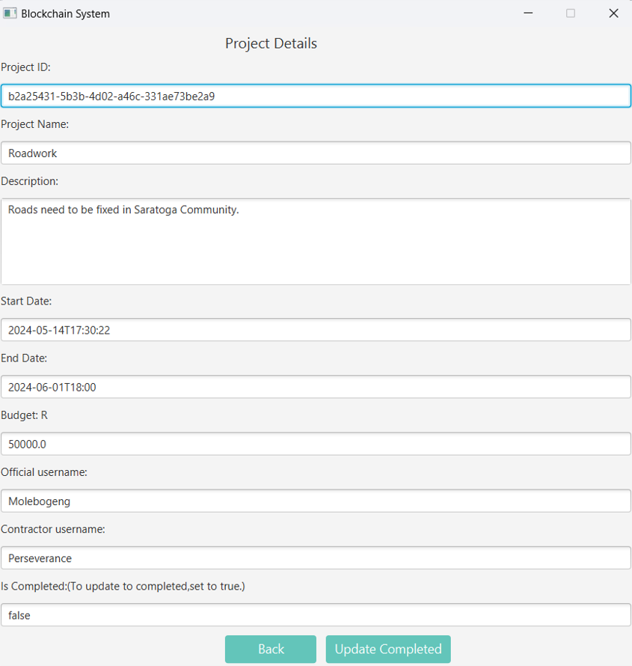
Project details will be displayed. NB Copy the Project ID to make transaction for the specific project

Slide 16
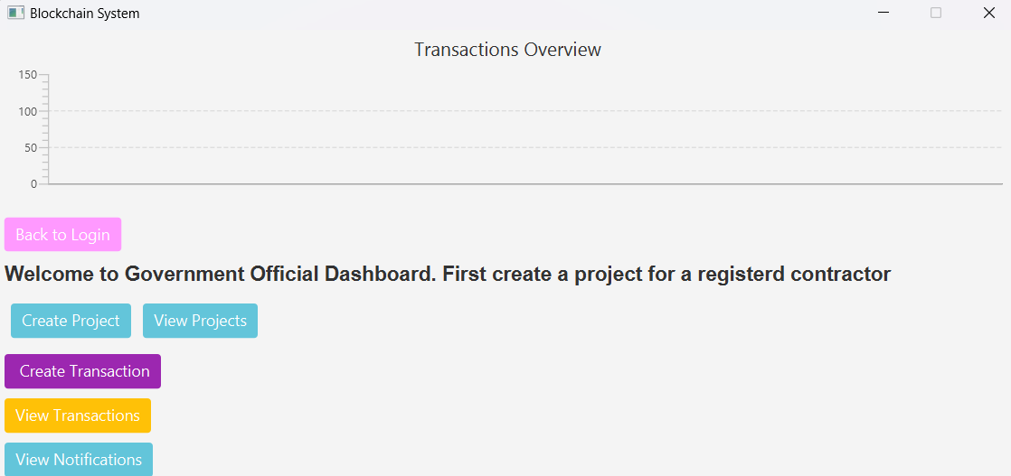
Navigate back to dashboard and click the Create Transaction Button to create a transaction for a project.

Slide 17
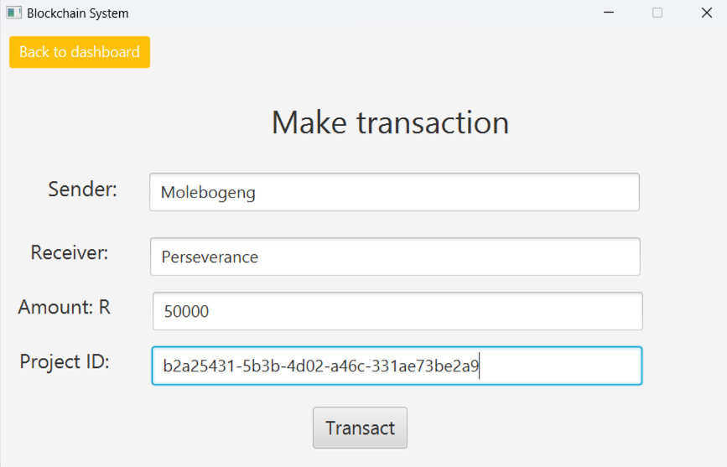
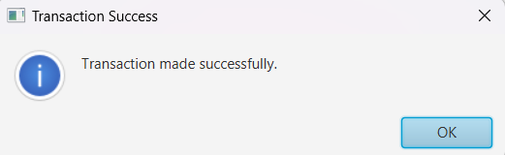
Enter the details to create a transaction. NB Paste the copied project ID. Then click transact.

Slide 18
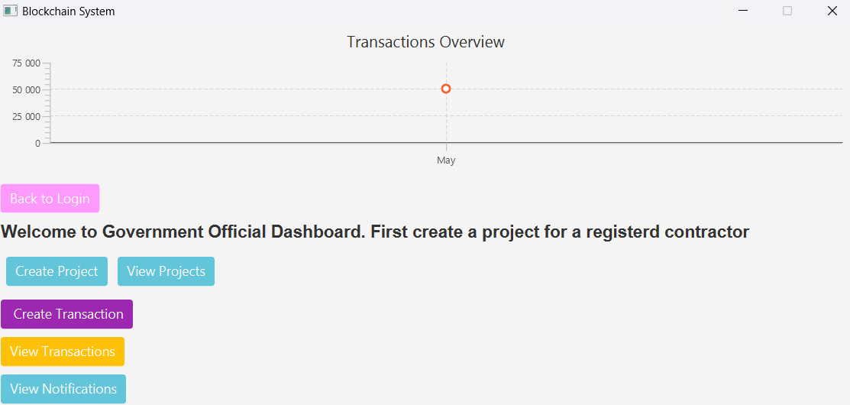
Graph populates per made transaction
Click on view transactions to view the transactions made.

Slide 19
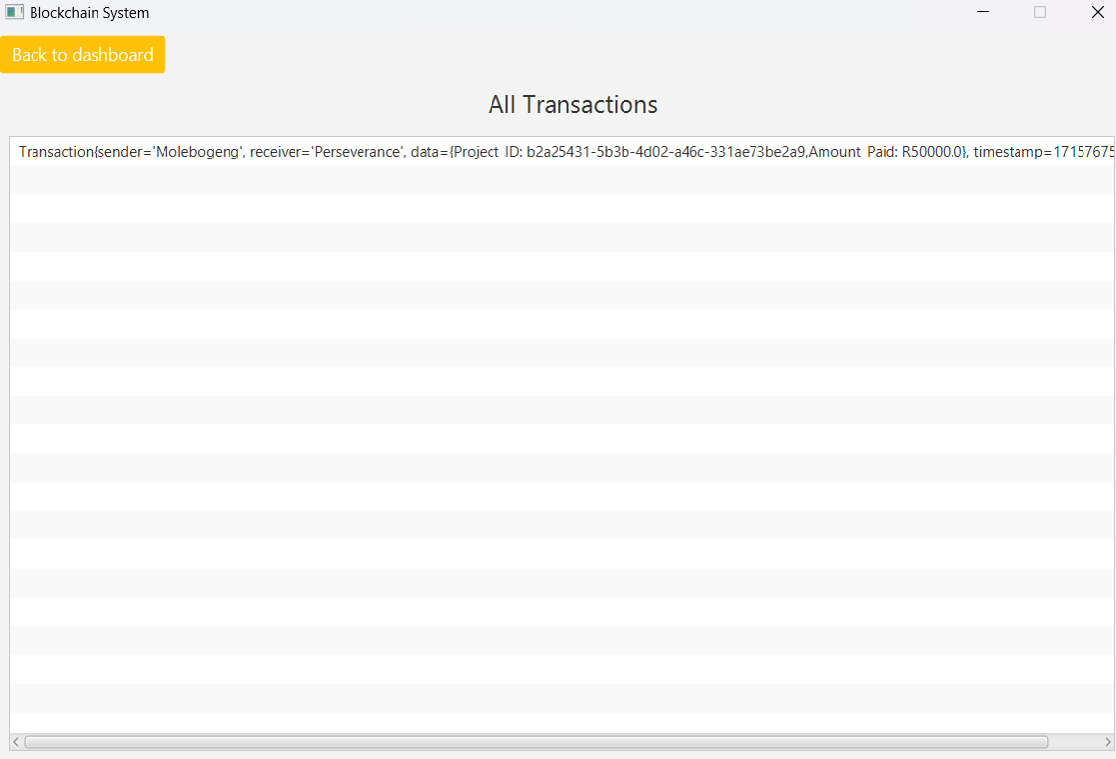
The transaction displayed, stored in the blockchain. It populates per made transaction.

Slide 20
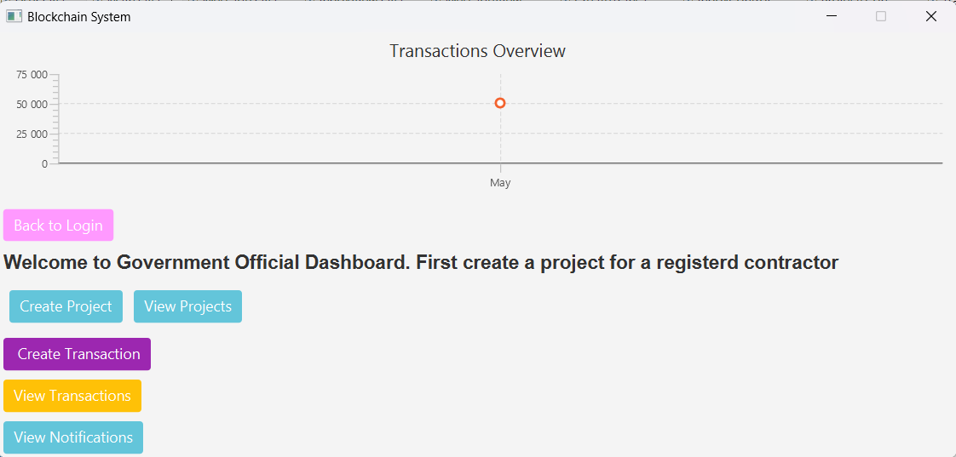
Navigate back to dashboard and click on view notifications to check for any notifications.

Slide 21
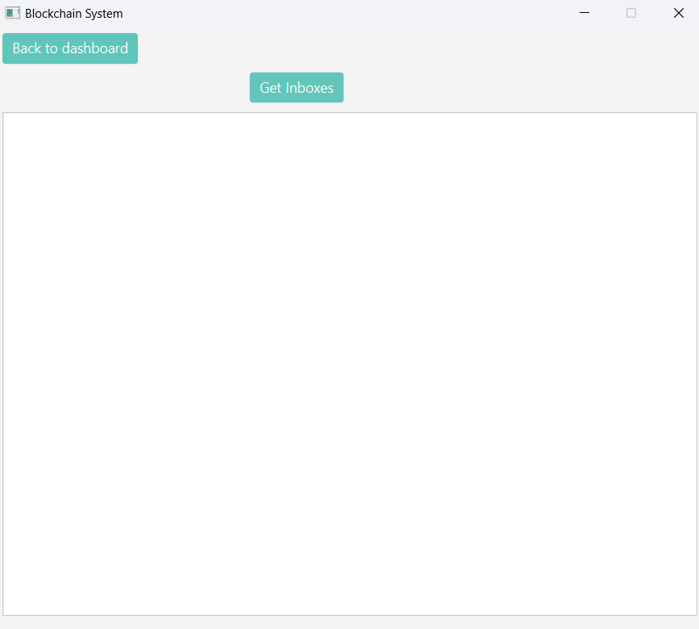
Click get Inboxes. Notifications are currently empty

Slide 22
Navigate back to dashboard and then go back to log in, to log in as contractor.

Slide 23
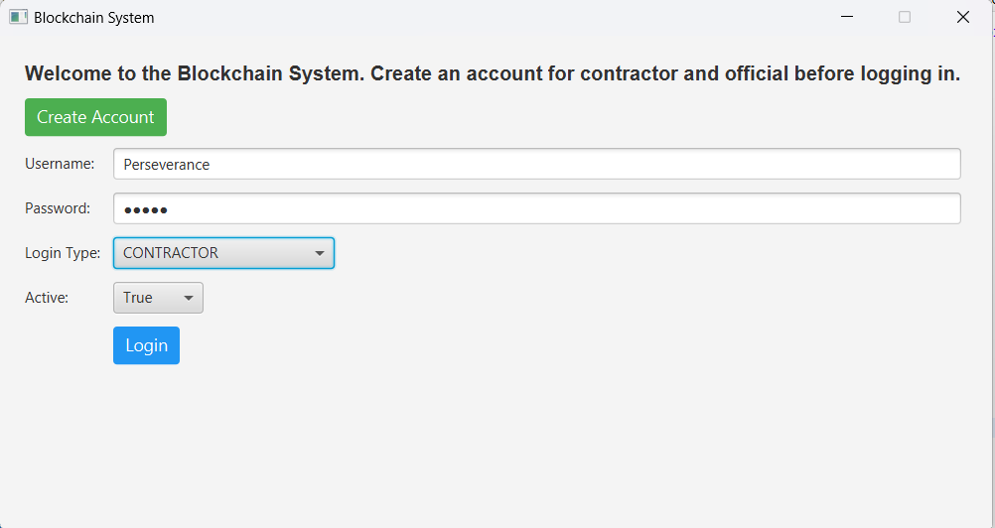
Login as contractor.

Slide 24
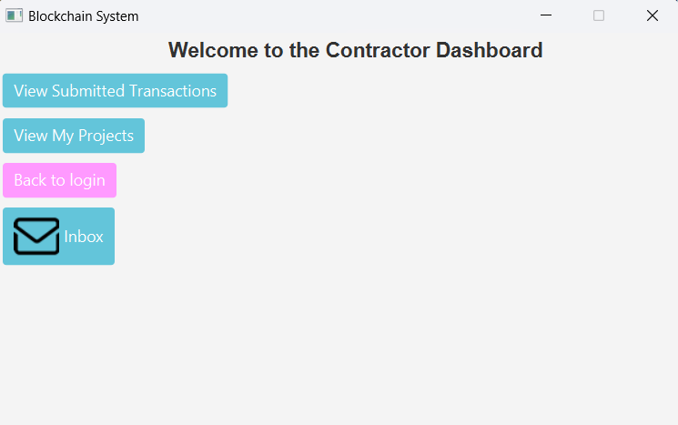
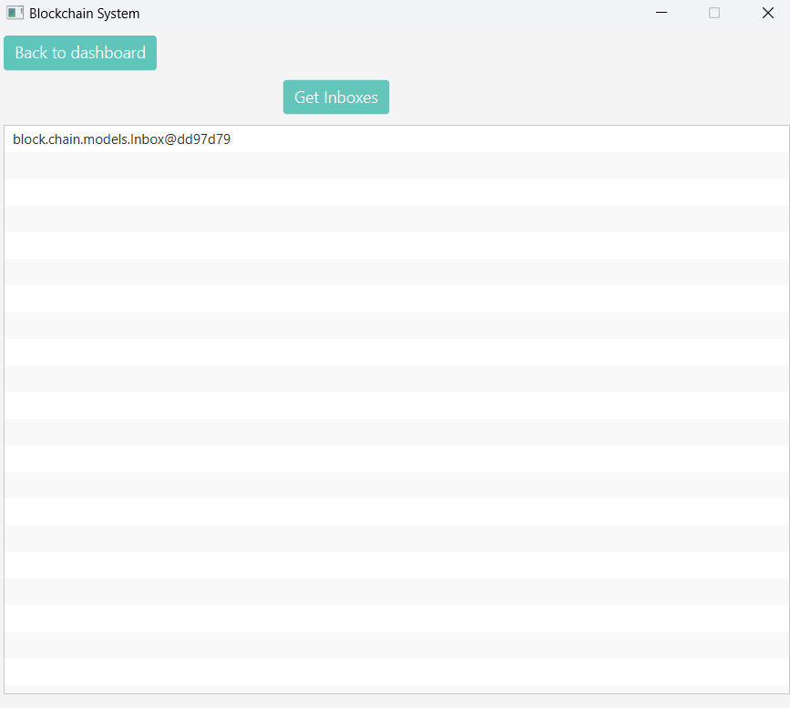
Contractor can view all submitted transactions similar to the Government official
Contractor can view transactions made to them only ,so they can complete the project
Contractor has an inbox, and views notifications made to them. To view message, click on the message

Slide 25
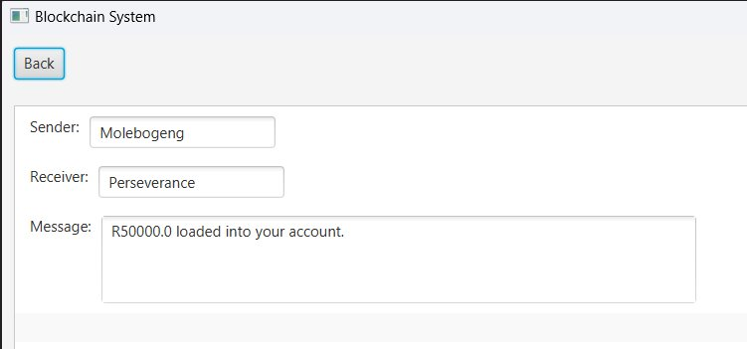
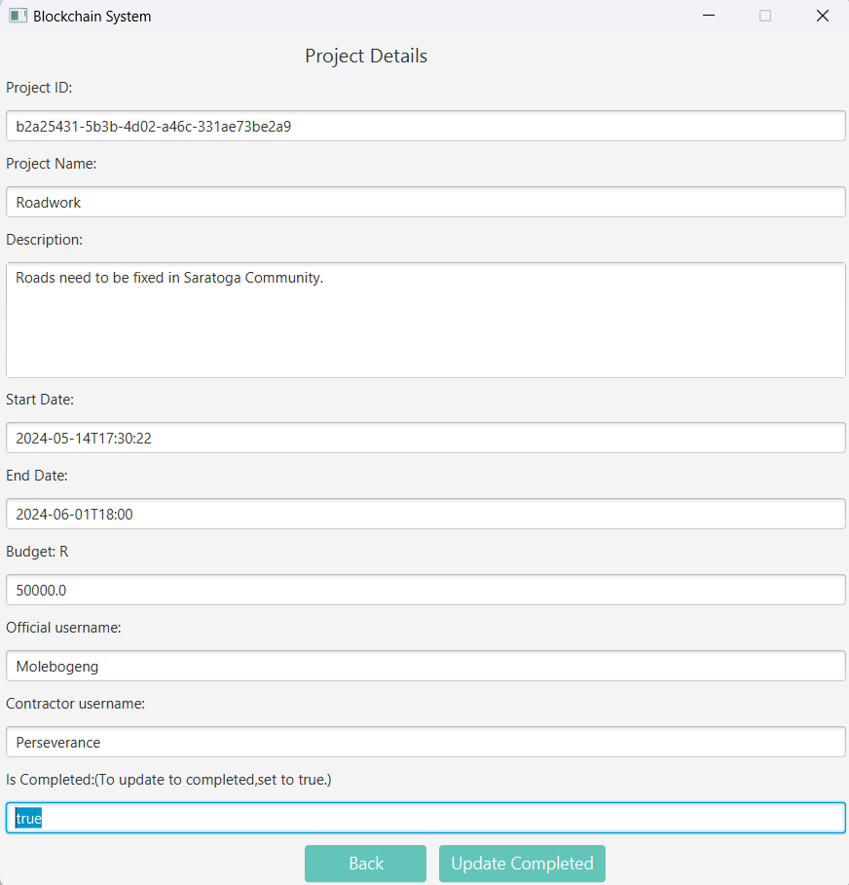
Message for the contractor
Contractor sets project status to true after completing project.

Slide 26
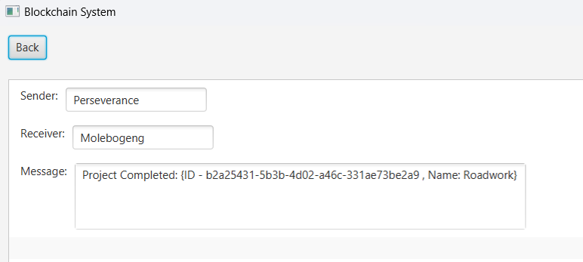
Government Official is notified of completed project.

Slide 27
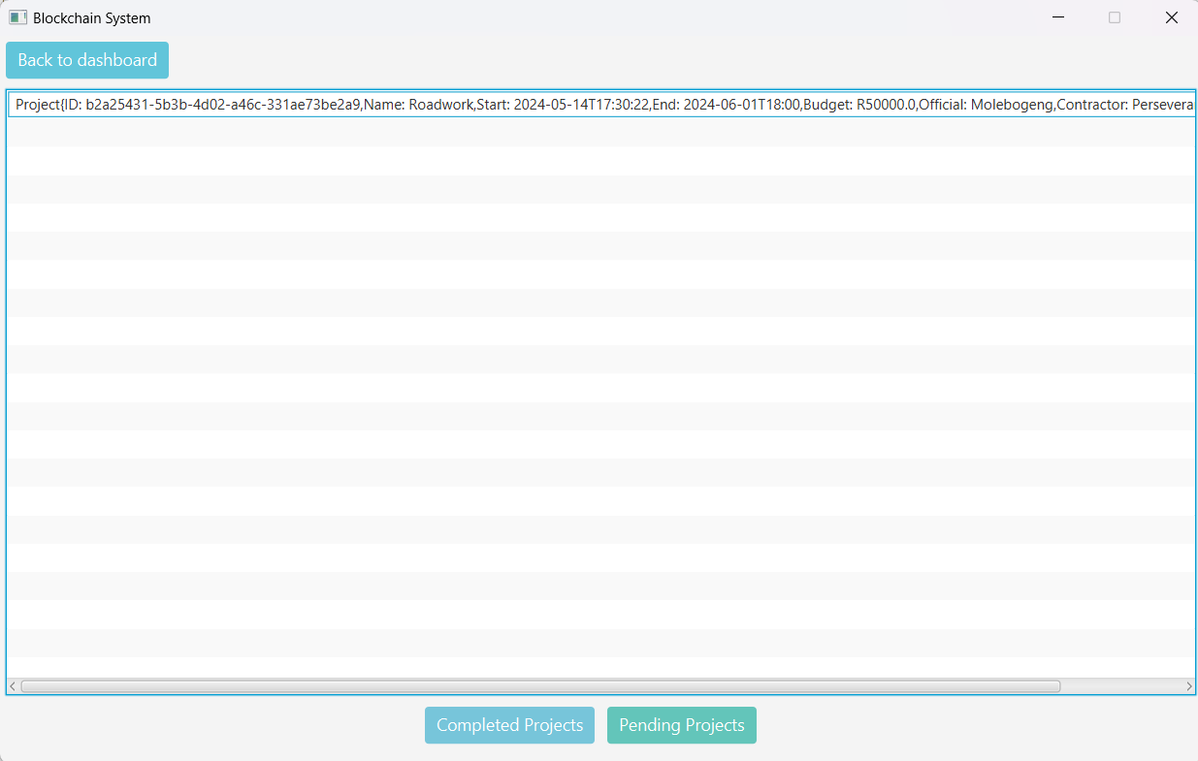
Project is now available under completed projects.

Slide 28
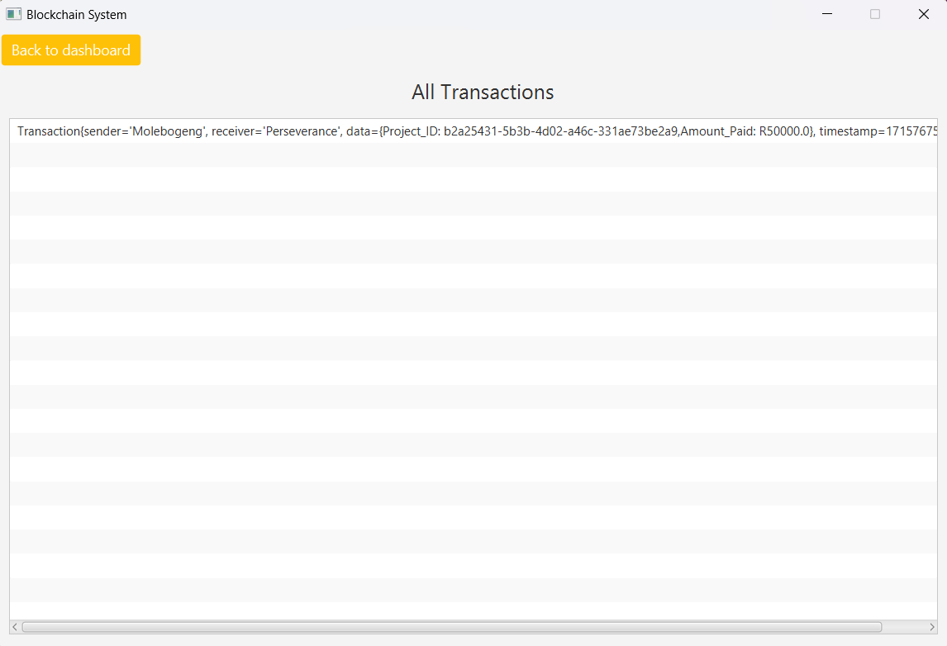
Overall, All transactions and communications are tracked between official and contractor.

Slide 29
THANK YOU
Molebogeng Baloyi
221048179
CSC3A Blockchain MiniProject

